Slide 1
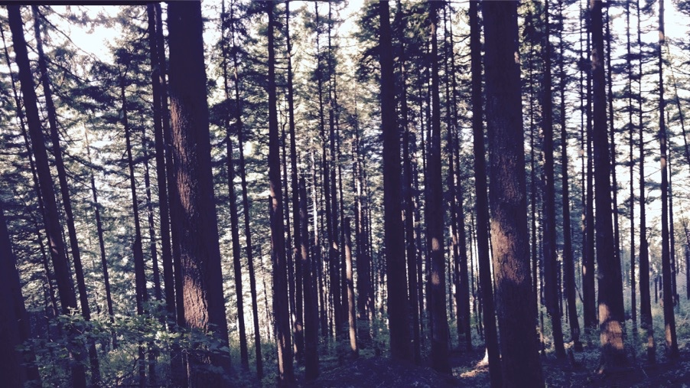
Photosynthetic acclimation to global change: improved understanding for more reliable predictions
Nick Smith
Lizz Waring, Evan Perkowski, Alissar Cheaib, Helen Scott, Zinny Ezekannagha
Isa Beltran, Dinah Borus, Kelly Carroll, Snehanjana Chatterjee, Jeff Chieppa, Rafael Freitas, Eve Gray, Monika Kelley, Risa McNellis, Brad Posch
Texas Tech University
nick.smith@ttu.edu

Slide 2



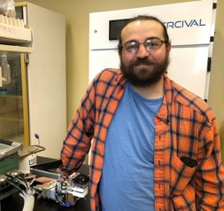

Thank you
ESA for selecting me as an Early Career Fellow
Our amazing lab and scientific network
Lizz Waring, Evan Perkowski, Jeff Chieppa, & Jeff Dukes (ECF nominators)
Lizz Waring
Evan Perkowski
Jeff Chieppa
Jeff Dukes

Slide 3
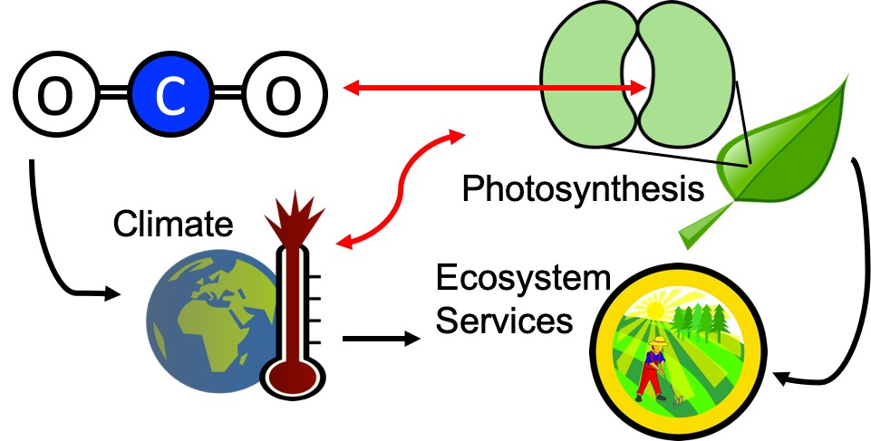
Our lab examines photosynthesis as a regulator of global change impacts on ecosystem services

Slide 4
Photosynthesis provides the foundation for other services
FNAL

Slide 5
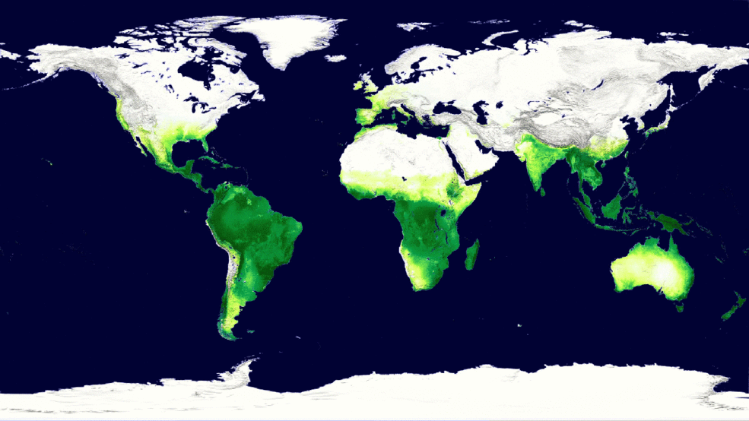
Photosynthesis is a dynamic process that is likely to be impacted by global change
MODIS, NASA

Slide 6
But predictions are uncertain!
Friedlingstein et al. (2014)

Slide 7
But predictions are uncertain!
Future model uncertainty (14 Pg) > current fossil fuel emissions (9.5 Pg)
Friedlingstein et al. (2014)

Slide 8
This uncertainty is driven by uncertainty in photosynthesis
Modeled change in photosynthesis
Modeled change in land C flux
Friedlingstein et al. (2014)
Keenan et al. (in review)

Slide 9

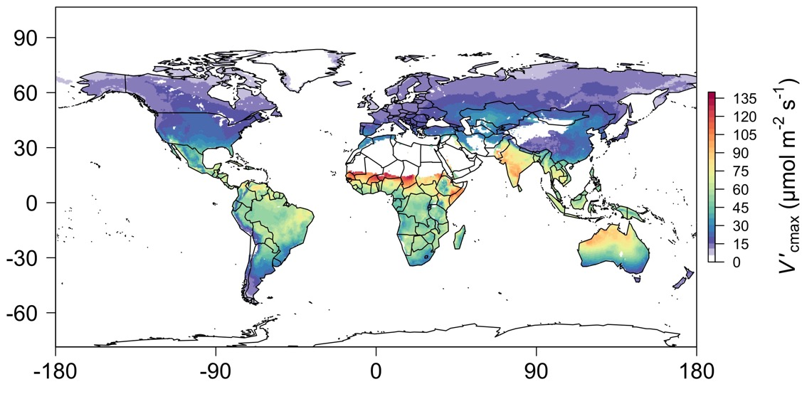
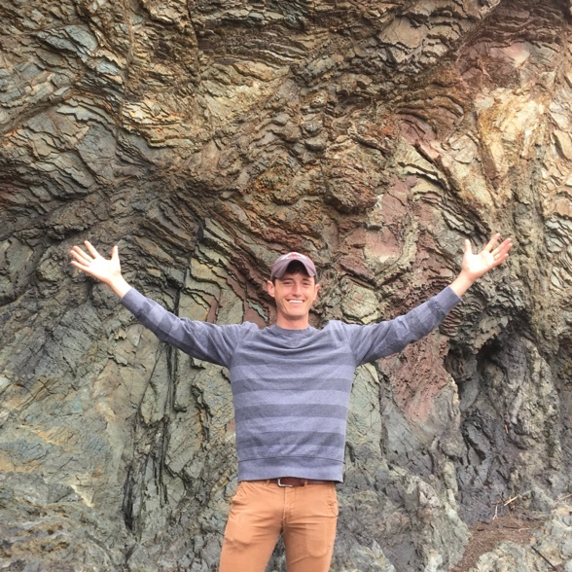
When starting the lab in 2017, I “knew” I had the answer!
photosynthetic capacity
Photosynthetic capacity
photosynthetic capacity
Smith et al. (2019)

Slide 10
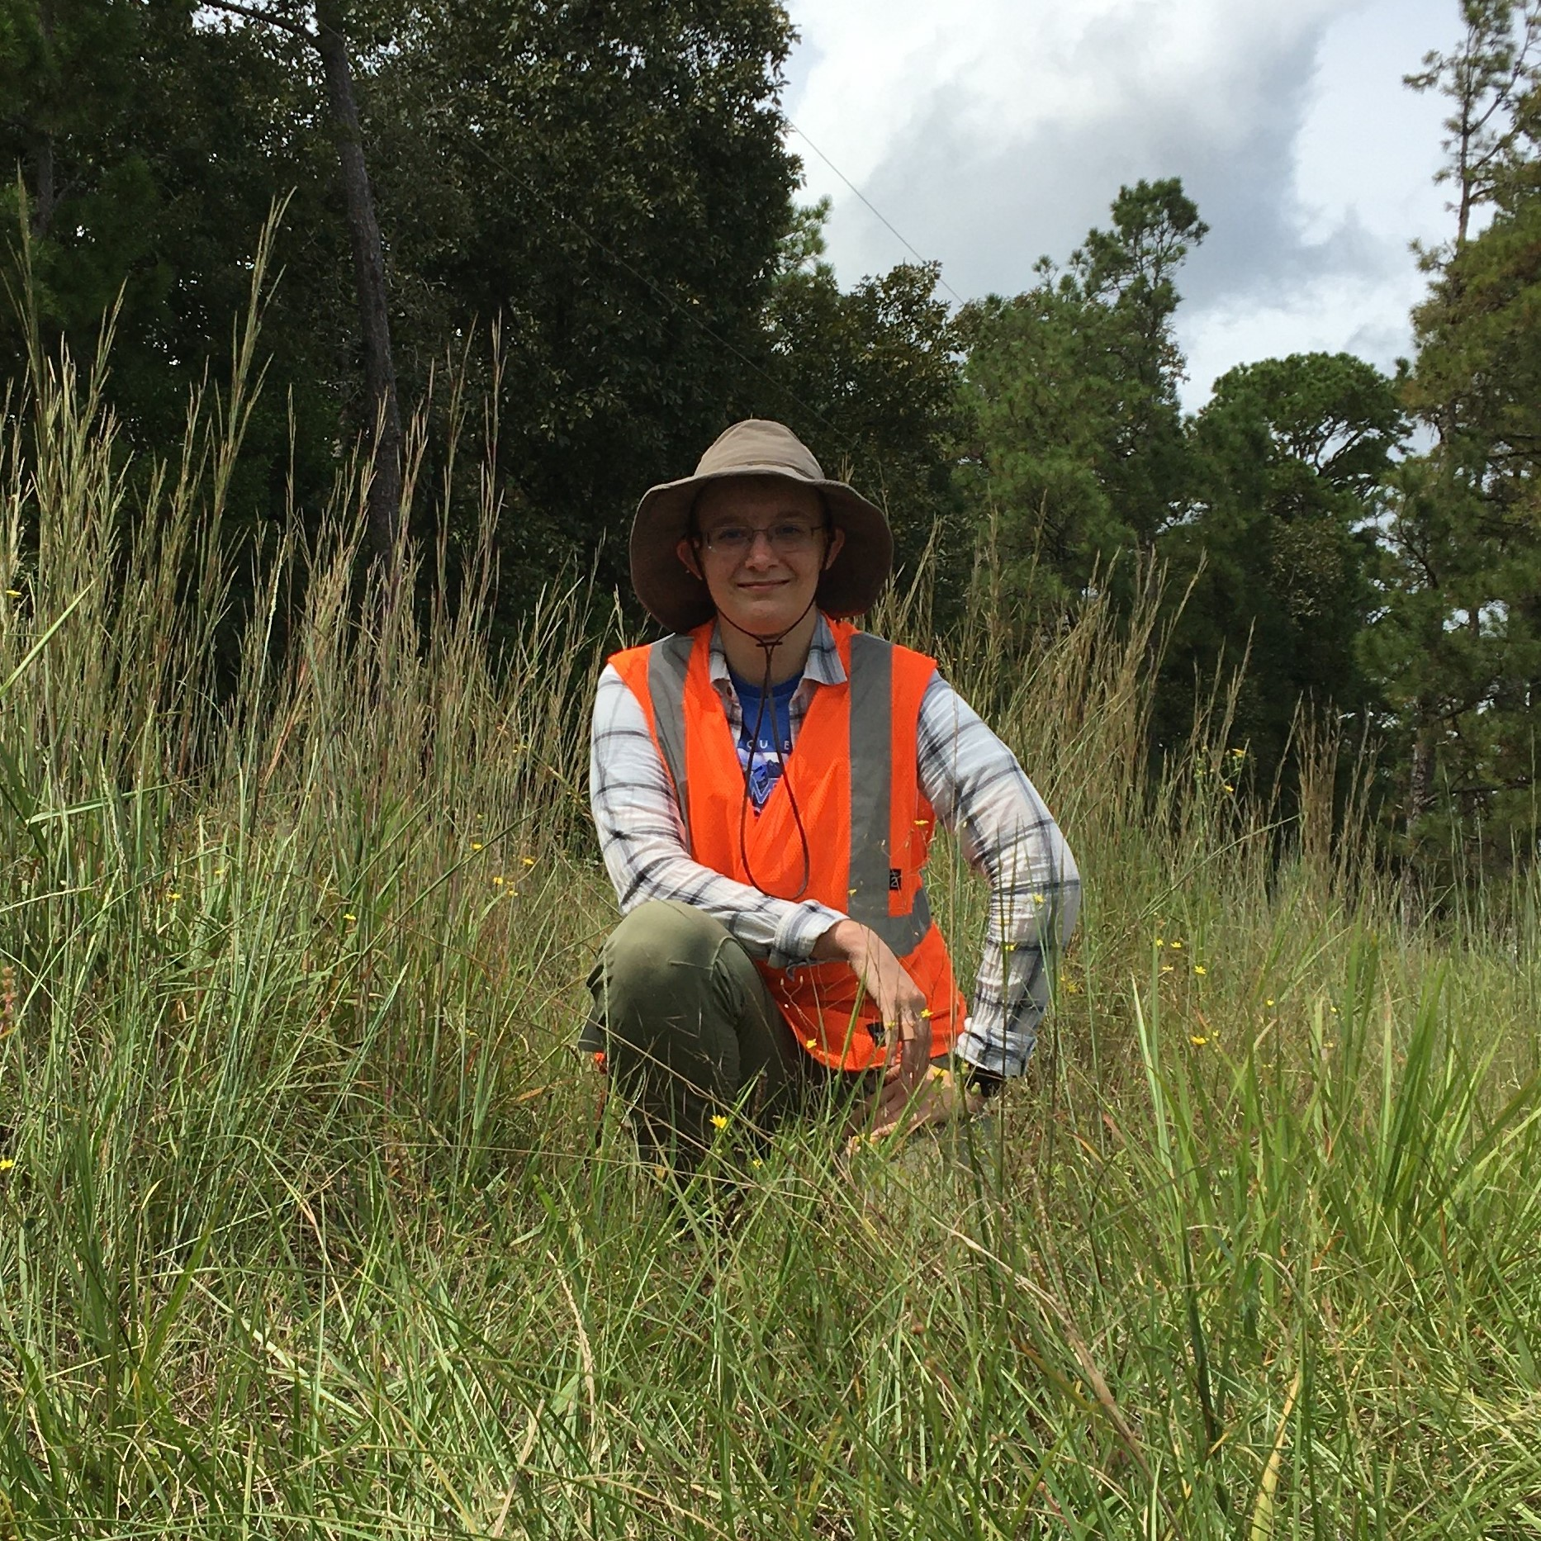
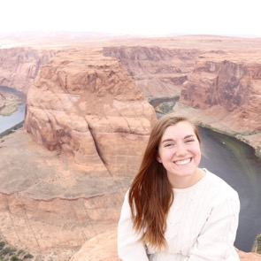
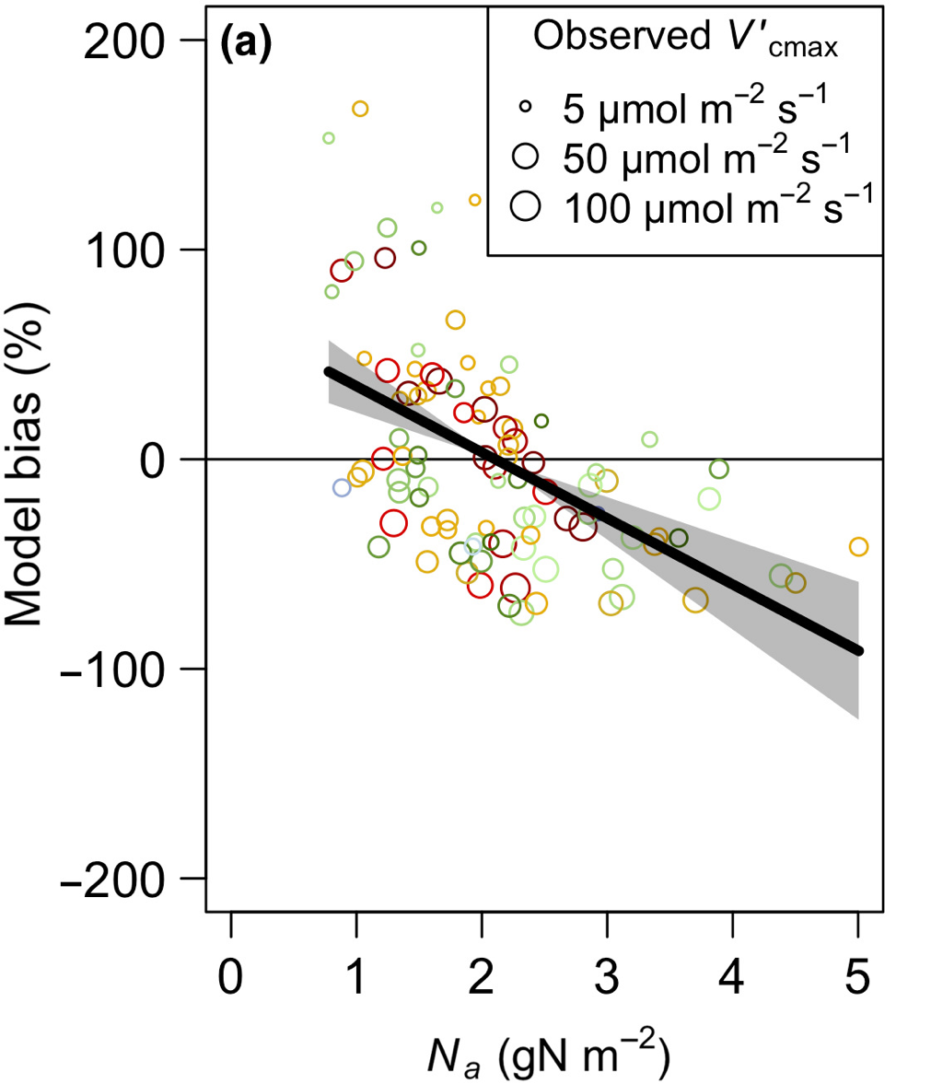
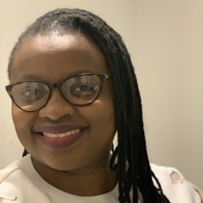
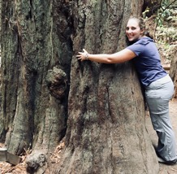
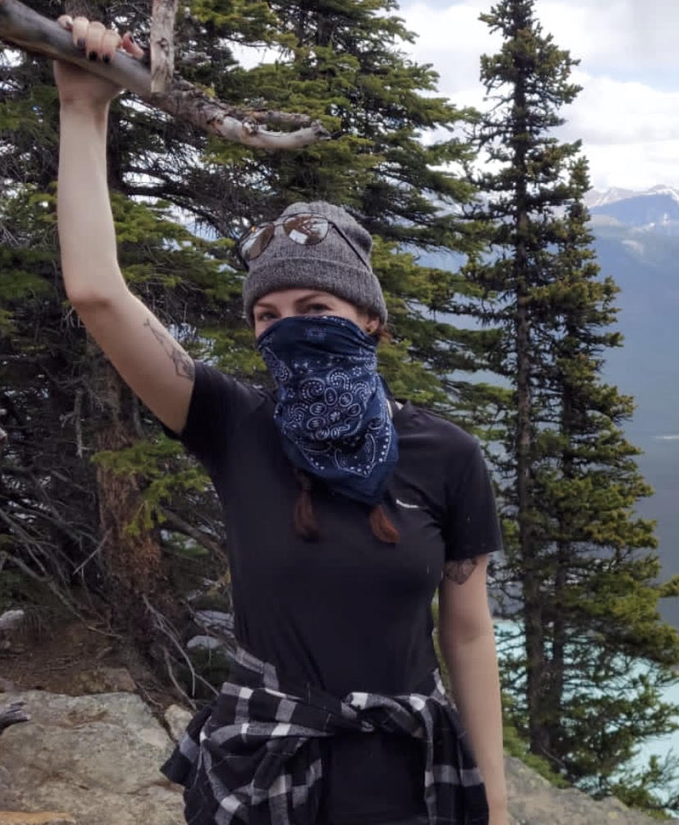
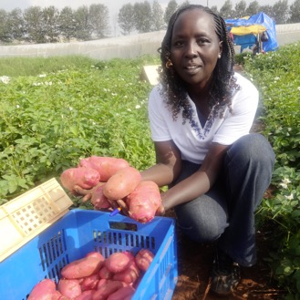
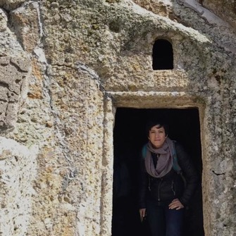
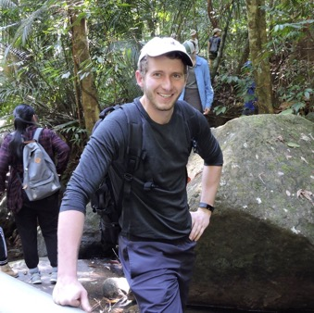


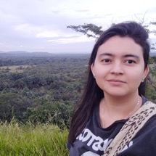
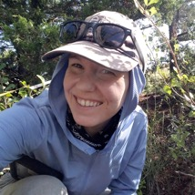
Not everyone agreed
Photosynthetic capacity

Slide 11
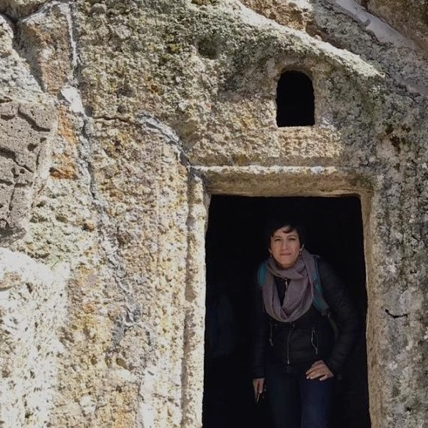
Questioning Nick’s worldview
Lizz Waring
Evan Perkowski
Alissar Cheaib

Slide 12
Questioning Nick’s worldview
Nick: photosynthetic capacity is primarily demand-driven

Slide 13
Questioning Nick’s worldview
Nick: photosynthetic capacity is primarily demand-driven
Others: nutrient availability matters too!
Lizz Waring
Evan Perkowski
Alissar Cheaib

Slide 14
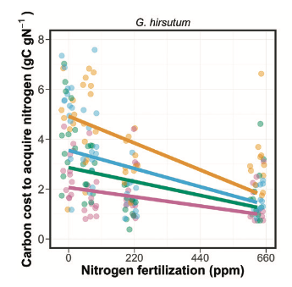
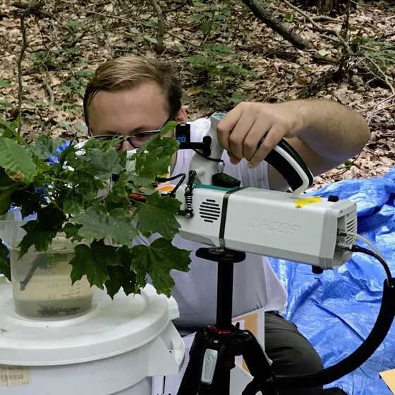
Scientific lesson: nutrient availability reduces carbon costs to acquire them
Evan Perkowski
Perkowski et al. (2021)

Slide 15
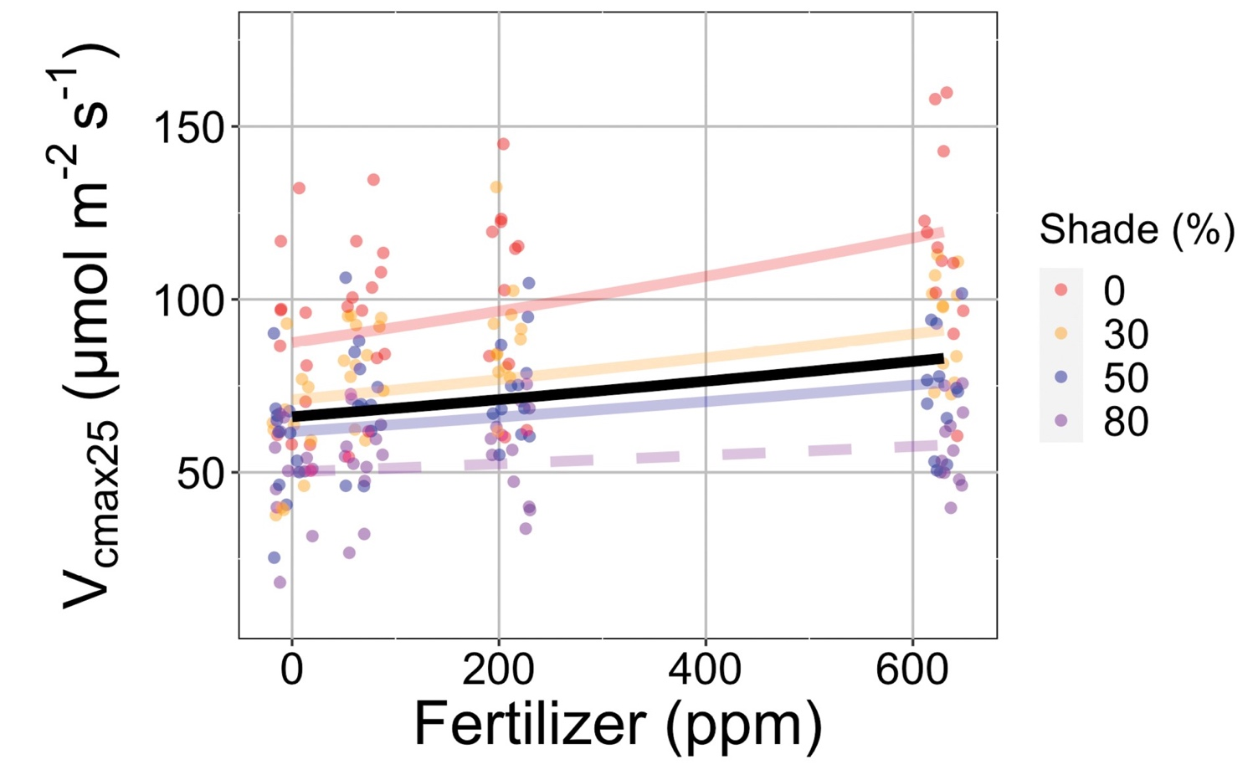
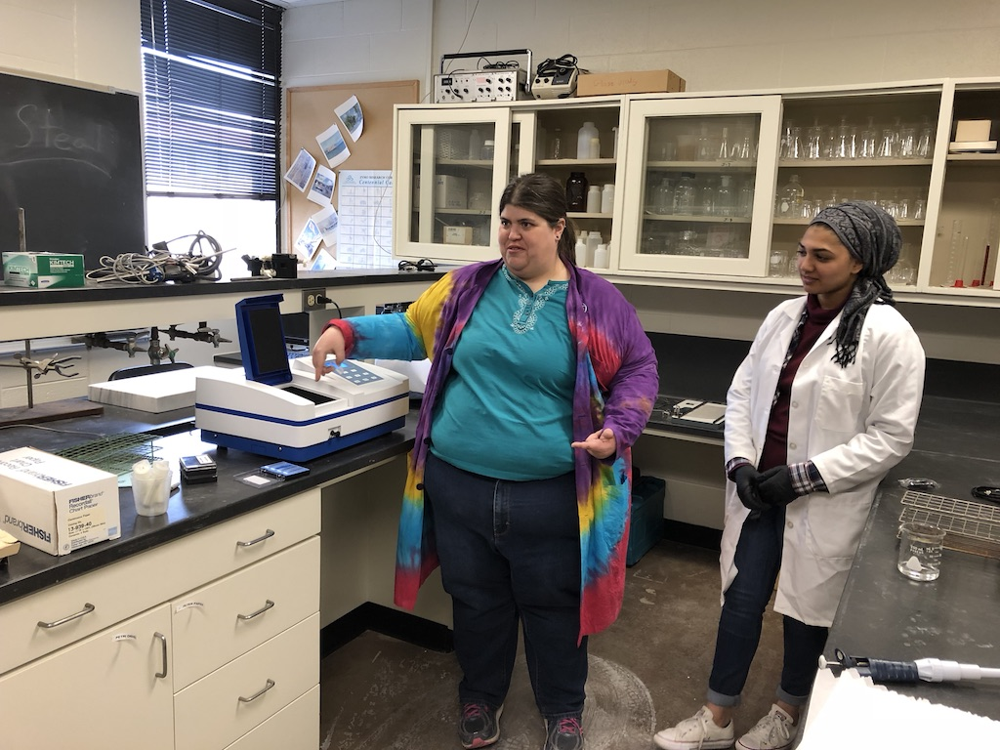
Scientific lesson: nutrient availability and nutrient demand drive photosynthetic capacity
N demand
Photosynthetic capacity
N availability
Lizz Waring
Waring et al. (2023)

Slide 16
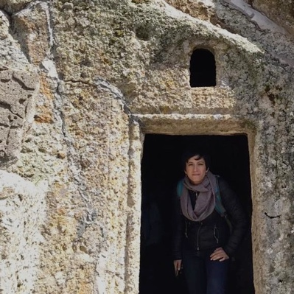
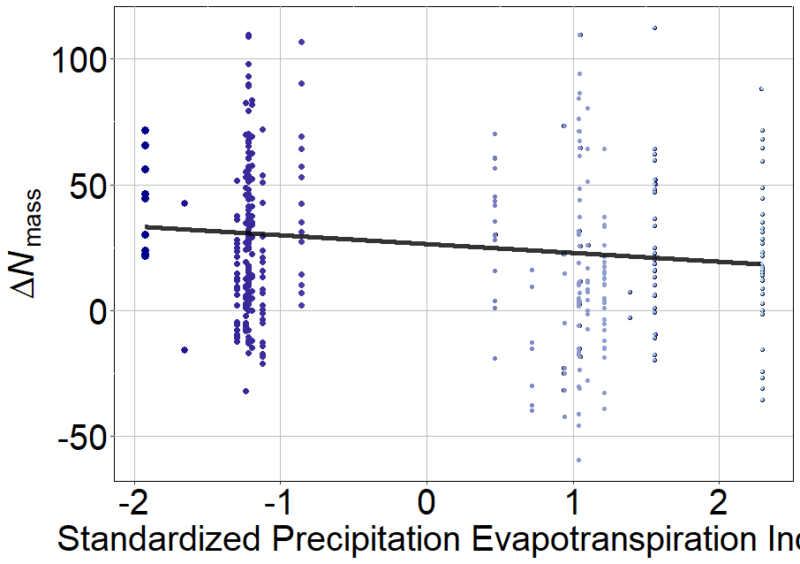
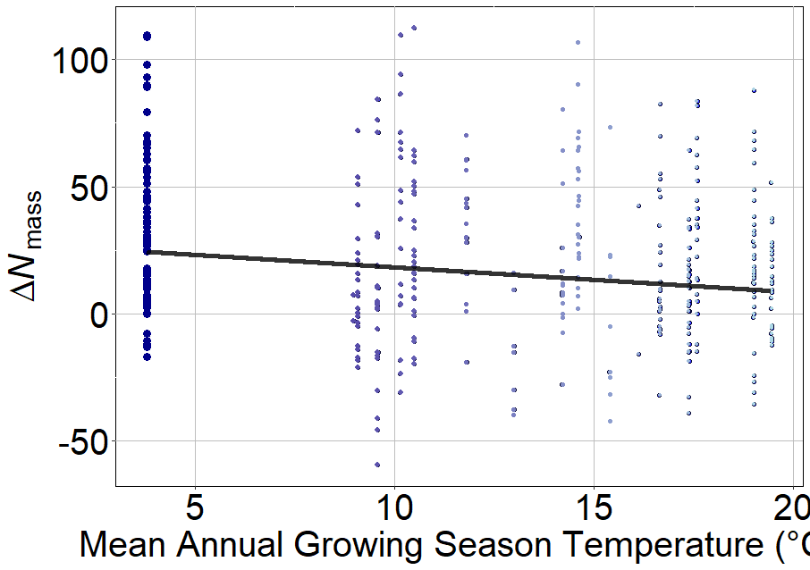
Scientific lesson: nutrient demand increases responses to nutrient availability
Alissar Cheaib
Leaf N response to soil N fertilization
Leaf N response to soil N fertilization
Dry → Wet
Cold → Warm
Cheaib et al. (in prep)

Slide 17
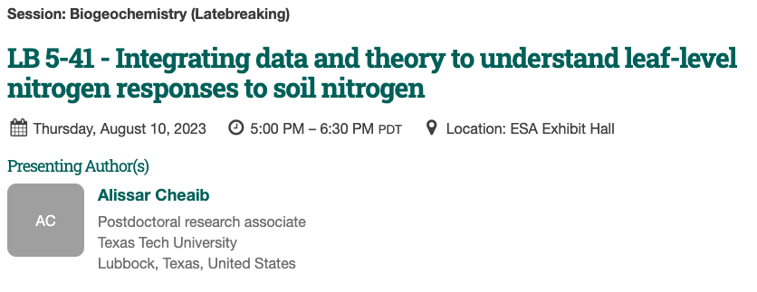
Scientific lesson: nutrient demand increases responses to nutrient availability
Dry → Wet
Cold → Warm

Slide 18
Questioning Nick’s worldview
Nick: photosynthetic capacity is primarily demand-driven
Others: nutrient availability matters too!
Nick: plants uptake nutrients to meet photosynthetic demand
Lizz Waring
Evan Perkowski
Alissar Cheaib

Slide 19
Questioning Nick’s worldview
Nick: photosynthetic capacity is primarily demand-driven
Others: nutrient availability matters too!
Nick: plants uptake nutrients to meet photosynthetic demand
Others: plants uptake nutrients for lots of other things!
Lizz Waring
Evan Perkowski
Alissar Cheaib

Slide 20
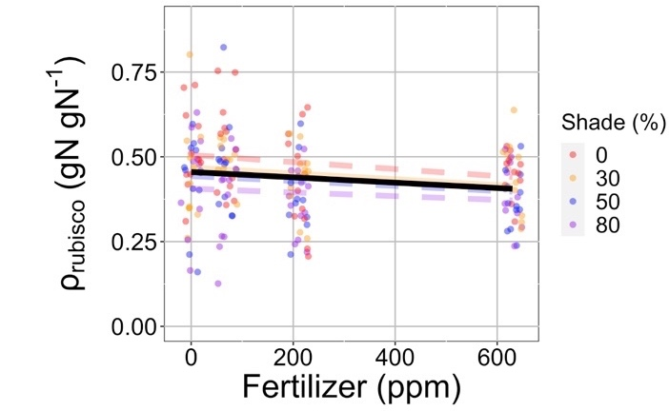
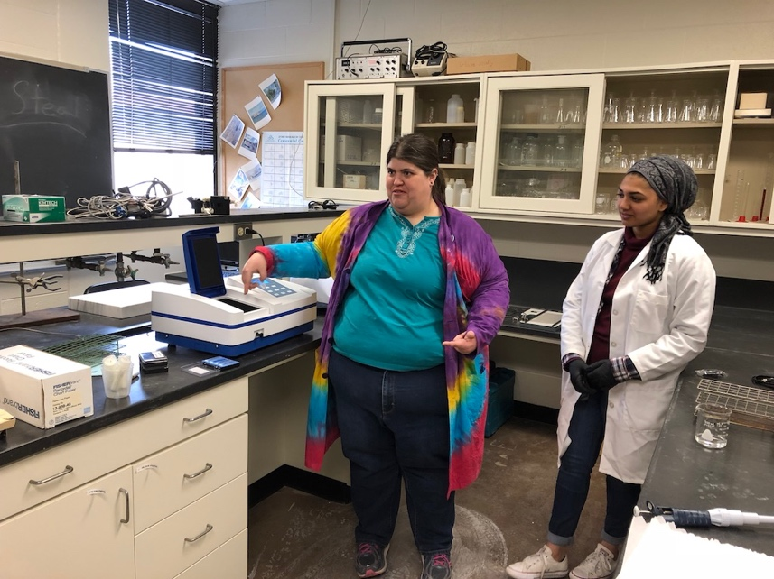
Scientific lesson: nutrient availability doesn’t just influence photosynthesis
Fraction N in Rubisco
Lizz Waring
*Consistent across multiple species, metrics, and growth conditions
Waring et al. (2023)

Slide 21
Questioning Nick’s worldview
Nick: photosynthetic capacity is primarily demand-driven
Others: nutrient availability matters too!
Nick: plants uptake nutrients to meet photosynthetic demand
Others: plants uptake nutrients for lots of other things!
Nick: plants downregulate photosynthetic capacity under elevated CO₂ to optimize nutrient use
Evan Perkowski
Alissar Cheaib

Slide 22
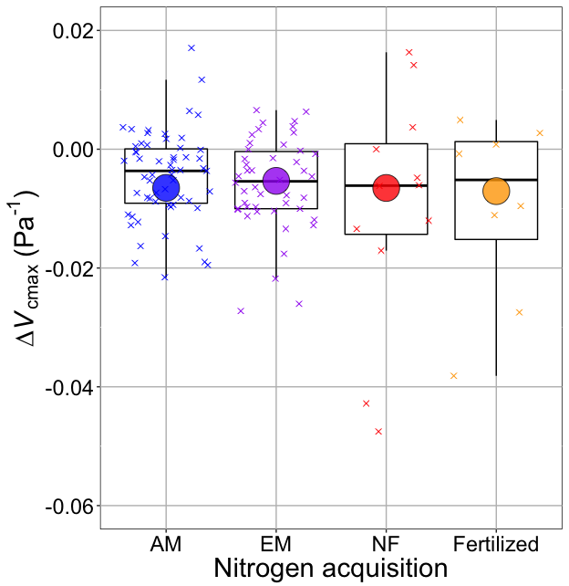
V_{cmax} changes with CO₂ in ways expected from optimization
Change in photosynthetic capacity
Boxes = data = -0.0063 Pa⁻¹
Circles = predicted = -0.0066 Pa⁻¹
Smith and Keenan (2020)

Slide 23
Questioning Nick’s worldview
Nick: photosynthetic capacity is primarily demand-driven
Others: nutrient availability matters too!
Nick: plants uptake nutrients to meet photosynthetic demand
Others: plants uptake nutrients for lots of other things!
Nick: plants downregulate photosynthetic capacity under elevated CO₂ to optimize nutrient use
Others: elevated CO₂ responses are the result of interactions between photosynthetic demand, nutrient availability, growth, and allocation
Evan Perkowski
Alissar Cheaib

Slide 24
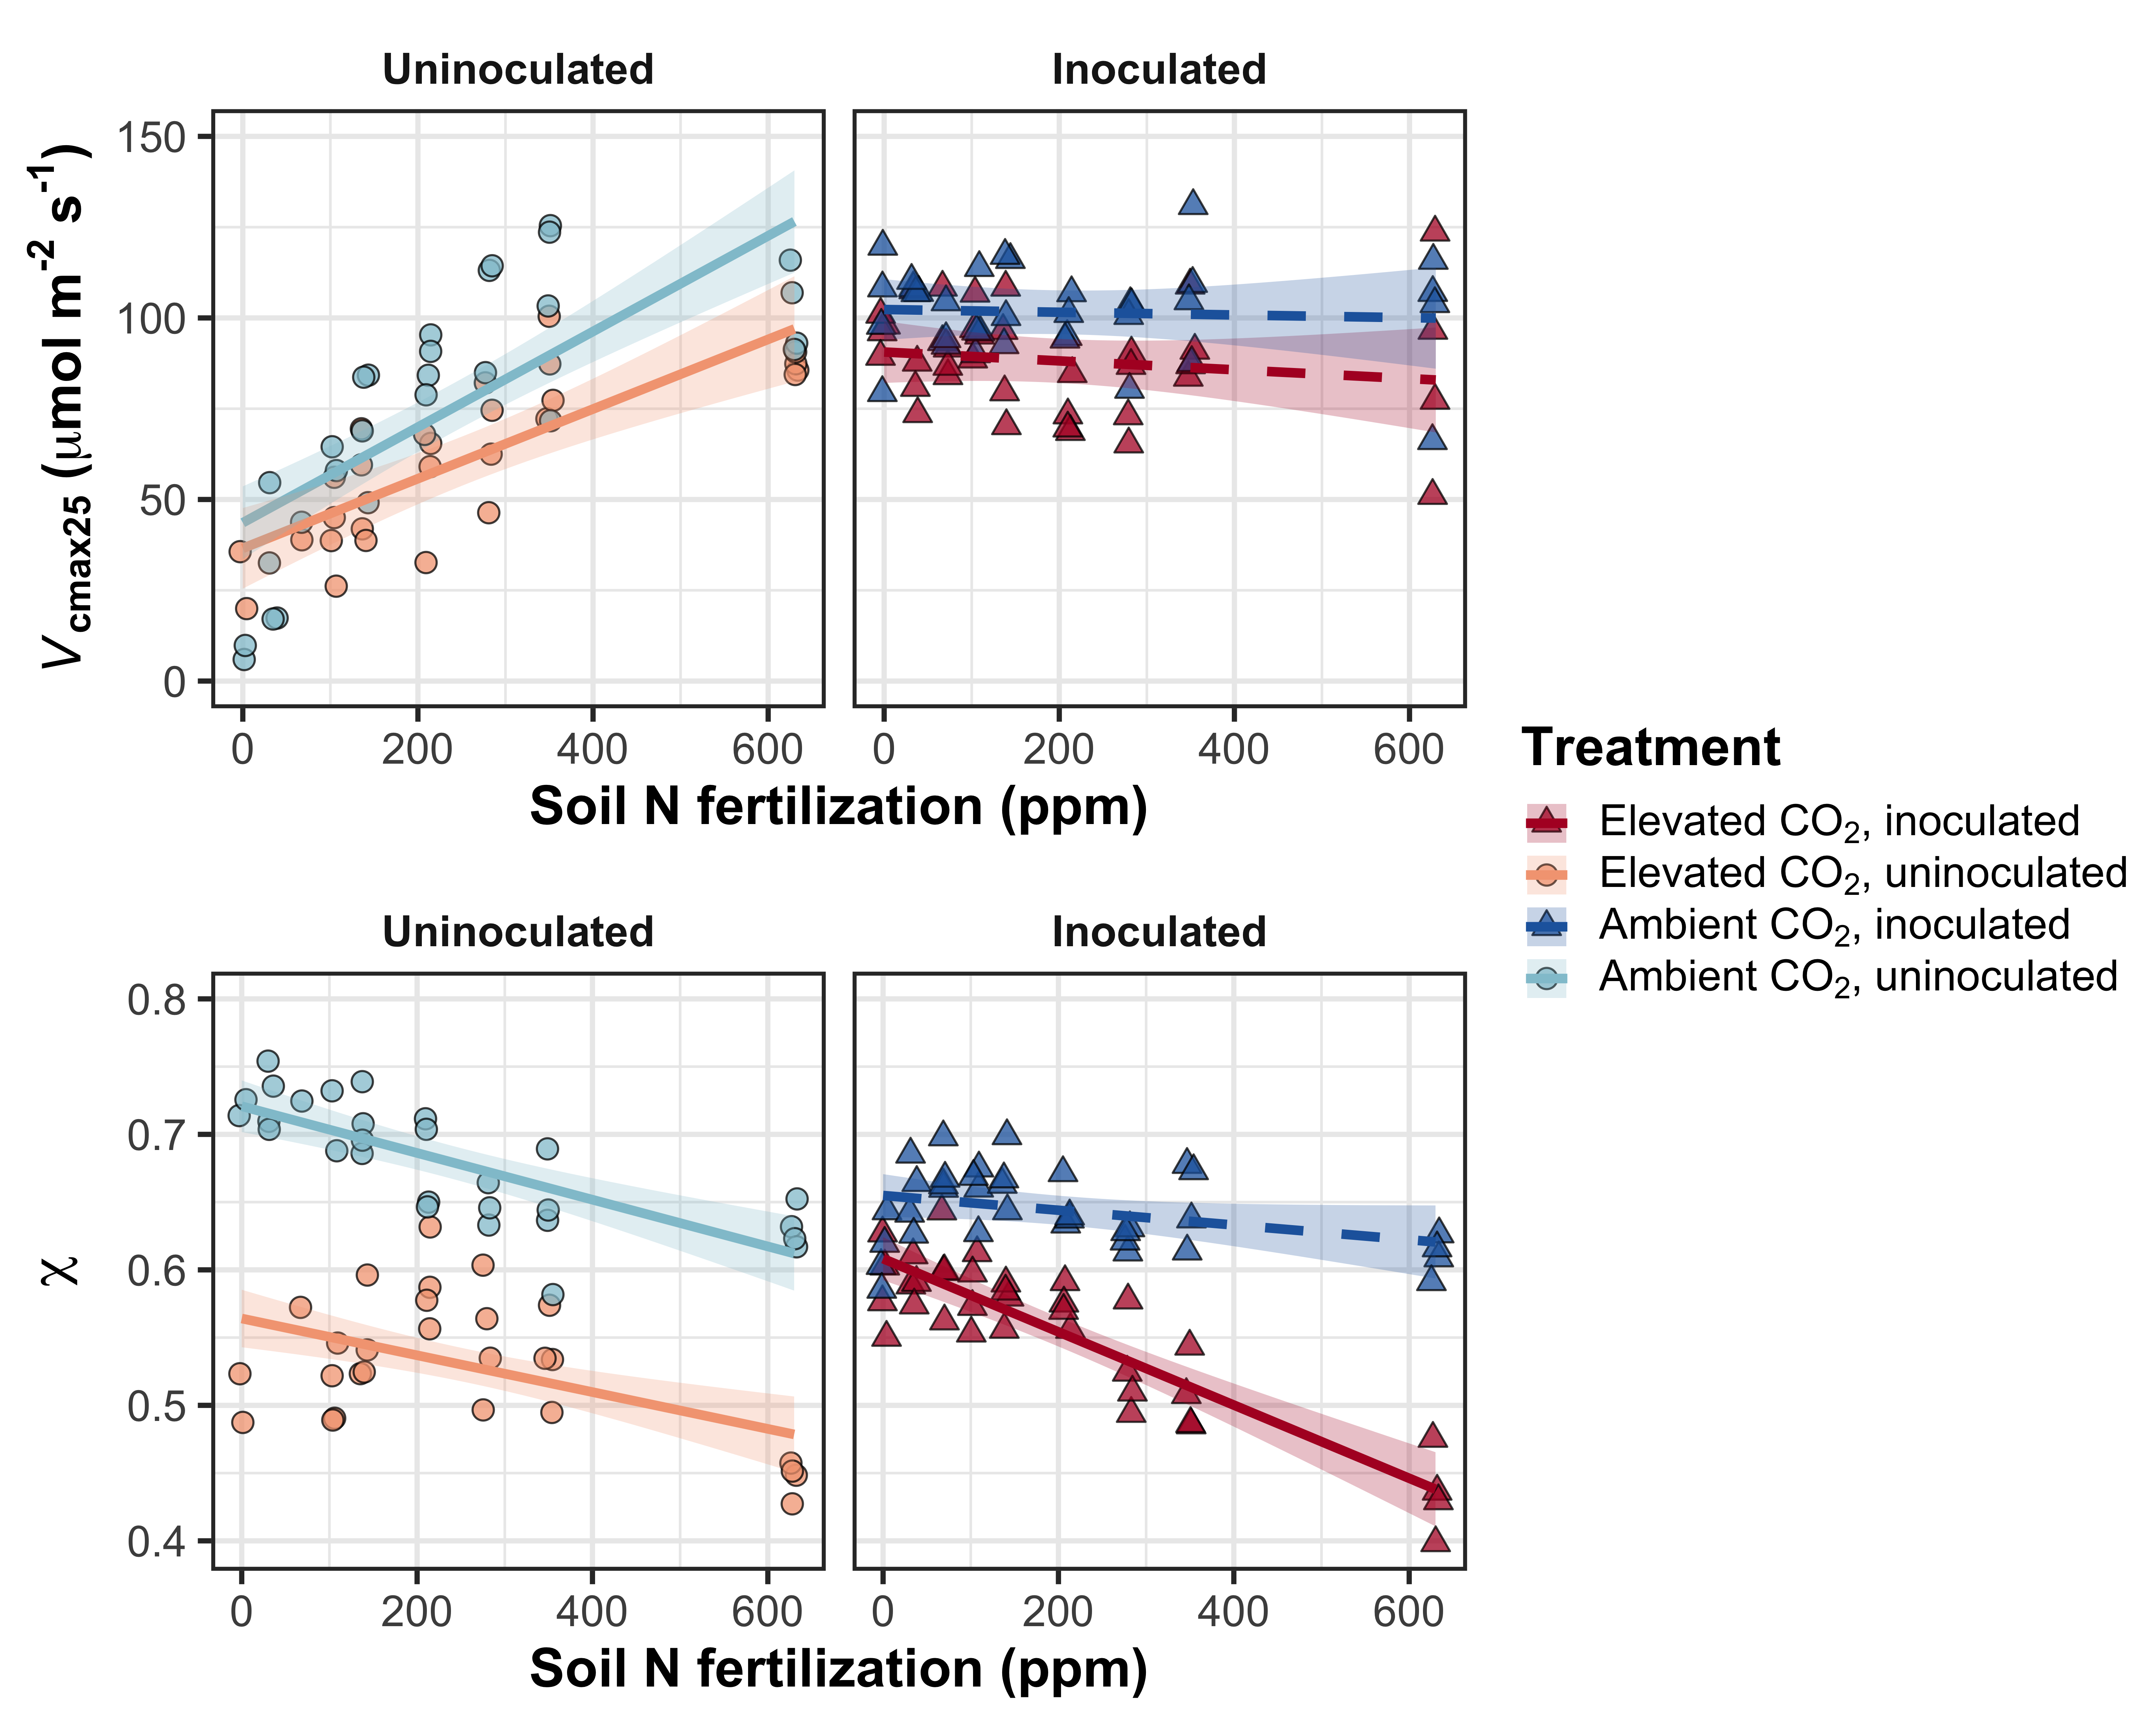
Scientific lesson: ok, maybe photosynthetic demand decreases regardless of other interactions
Evan Perkowski
Photosynthetic capacity
Perkowski et al. (in prep)

Slide 25
Scientific lesson: nitrogen availability still matters independently
Photosynthetic capacity
Evan Perkowski
Stomatal opening
Perkowski et al. (in prep)

Slide 26
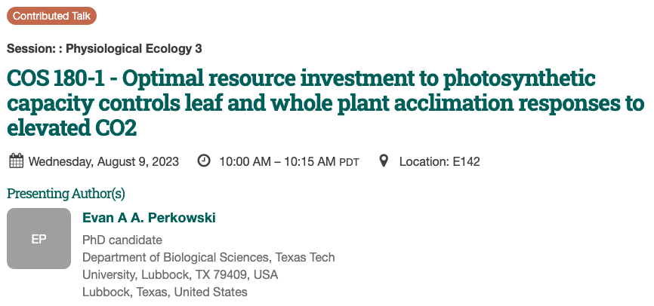
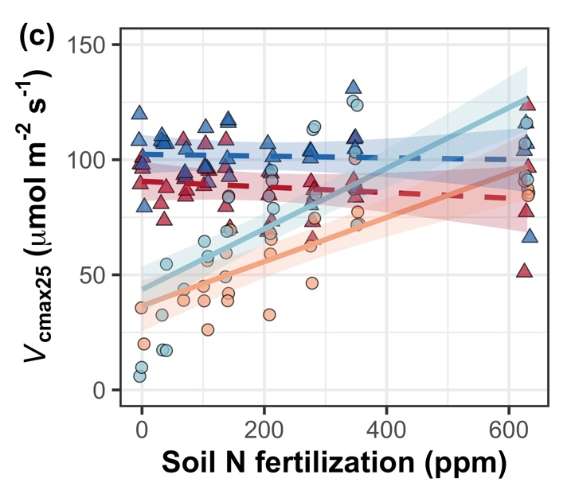
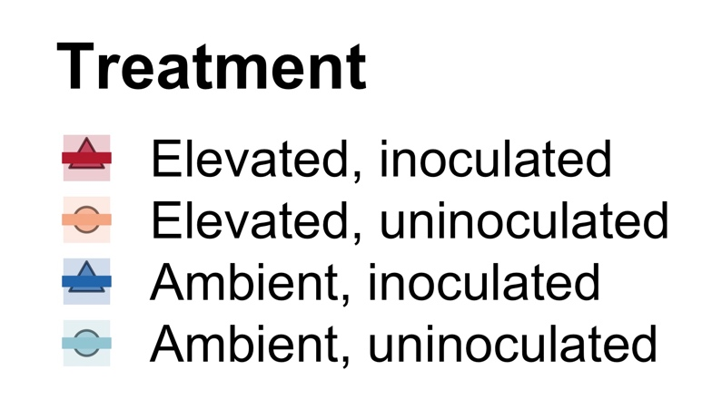
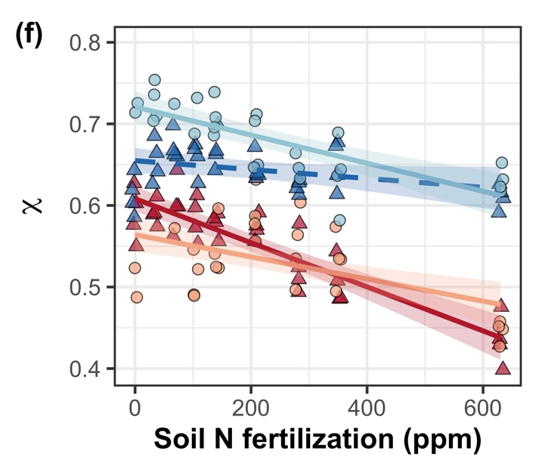
Scientific lesson: nitrogen availability still matters independently

Slide 27


Questioning Nick’s worldview
Nick: photosynthetic capacity is primarily demand-driven
Others: nutrient availability matters too!
Nick: plants uptake nutrients to meet photosynthetic demand
Others: plants uptake nutrients for lots of other things!
Nick: plants downregulate photosynthetic capacity under elevated CO₂ to optimize nutrient use
Others: elevated CO₂ responses are the result of interactions between photosynthetic demand, nutrient availability, growth, and allocation
Nick: we only need to worry about modeling C₃ acclimation
Helen Scott
Zinny Ezekannagha

Slide 28
Questioning Nick’s worldview
Nick: photosynthetic capacity is primarily demand-driven
Others: nutrient availability matters too!
Nick: plants uptake nutrients to meet photosynthetic demand
Others: plants uptake nutrients for lots of other things!
Nick: plants downregulate photosynthetic capacity under elevated CO₂ to optimize nutrient use
Others: elevated CO₂ responses are the result of interactions between photosynthetic demand, nutrient availability, growth, and allocation
Nick: we only need to worry about modeling C₃ acclimation
Others: C₄ plants are dynamic and important!
Helen Scott
Zinny Ezekannagha

Slide 29
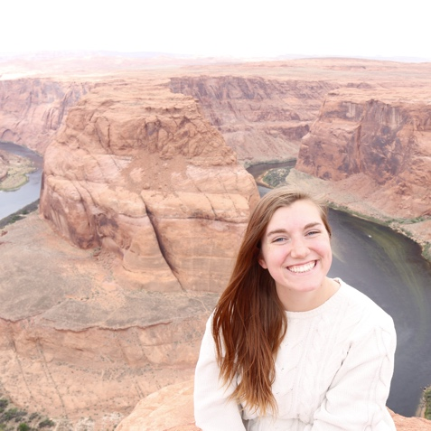
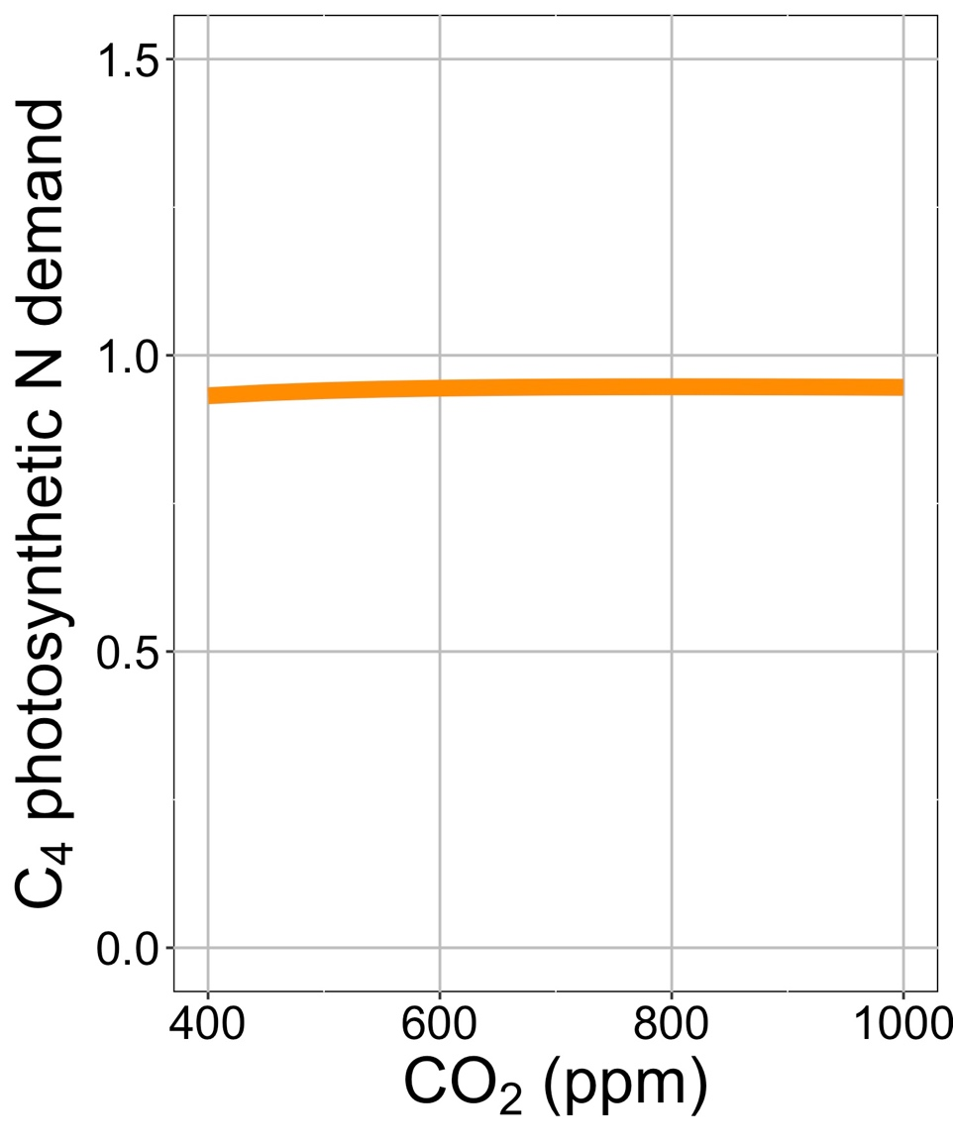
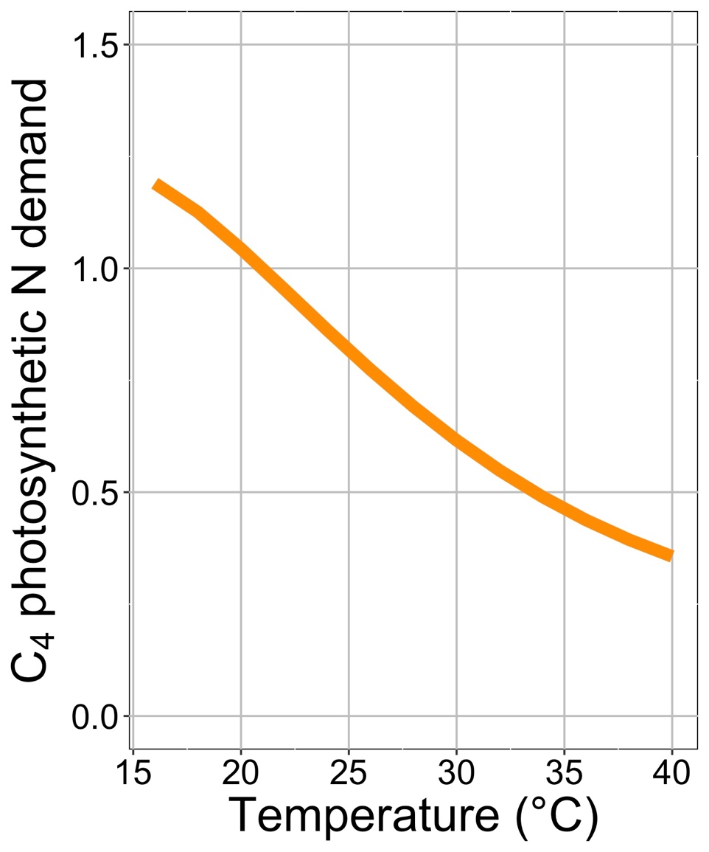
Scientific lesson: C₄ dynamism can be simulated
Helen Scott

Slide 30
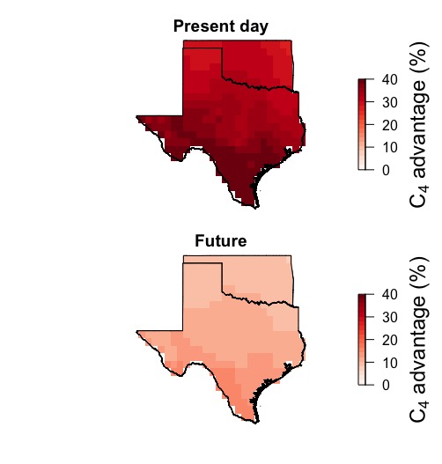
Scientific lesson: C₄ dynamics are likely important for predicting community change
Helen Scott
Zinny Ezekannagha
Ansley et al. (2023)

Slide 31

Questioning Nick’s worldview
Nick: photosynthetic capacity is primarily demand-driven
Others: nutrient availability matters too!
Nick: plants uptake nutrients to meet photosynthetic demand
Others: plants uptake nutrients for lots of other things!
Nick: plants downregulate photosynthetic capacity under elevated CO₂ to optimize nutrient use
Others: elevated CO₂ responses are the result of interactions between photosynthetic demand, nutrient availability, growth, and allocation
Nick: we only need to worry about modeling C₃ acclimation
Others: C₄ plants are dynamic and important!

Slide 32
Photosynthetic acclimation to global change: improved understanding for more reliable predictions
Nick Smith
Lizz Waring, Evan Perkowski, Alissar Cheaib, Helen Scott, Zinny Ezekannagha
Isa Beltran, Kelly Carroll, Snehanjana Chatterjee, Jeff Chieppa, Rafael Freitas, Eve Gray, Monika Kelley, Risa McNellis, Brad Posch
Texas Tech University
nick.smith@ttu.edu

Slide 33
Learning from mentees to better understand your science and your self
Nick Smith
Lizz Waring, Evan Perkowski, Alissar Cheaib, Helen Scott, Zinny Ezekannagha
Isa Beltran, Kelly Carroll, Snehanjana Chatterjee, Jeff Chieppa, Rafael Freitas, Eve Gray, Monika Kelley, Risa McNellis, Brad Posch
Texas Tech University
nick.smith@ttu.edu

Slide 34
Larger lessons learned from mentees about myself and approach to science

Slide 35
Larger lessons learned from mentees about myself and approach to science
Read, discuss, and debate with mentees

Slide 36
Larger lessons learned from mentees about myself and approach to science
Read, discuss, and debate with mentees
Listen to mentees

Slide 37
Larger lessons learned from mentees about myself and approach to science
Read, discuss, and debate with mentees
Listen to mentees
Reserve and prioritize time to teach and train

Slide 38
Larger lessons learned from mentees about myself and approach to science
Read, discuss, and debate with mentees
Listen to mentees
Reserve and prioritize time to teach and train
Help mentees achieve their goals, not yours

Slide 39
Larger lessons learned from mentees about myself and approach to science
Read, discuss, and debate with mentees
Listen to mentees
Reserve and prioritize time to teach and train
Help mentees achieve their goals, not yours
Go slow

Slide 40
Larger lessons learned from mentees about myself and approach to science
Read, discuss, and debate with mentees
Listen to mentees
Reserve and prioritize time to teach and train
Help mentees achieve their goals, not yours
Go slow
Be humble
Notes:
Disproving hypotheses is the scientific method

Slide 41
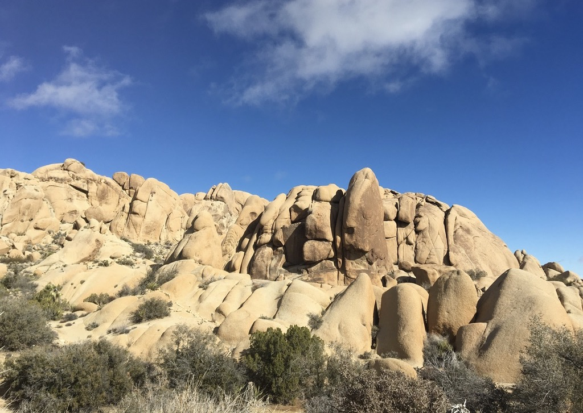


Presentation available at:
www.github.com/SmithEcophysLab/ESA_2023
Data and code:
www.github.com/SmithEcophysLab
www.smithecophyslab.com/data
Thanks!

